Slide 3
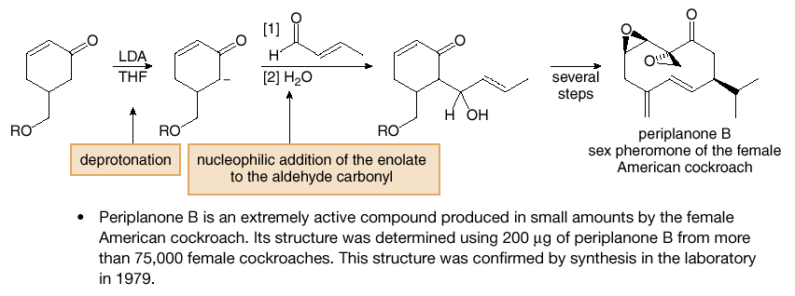
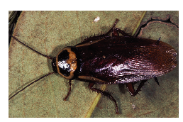
Carbonyl Condensation Reactions
Directed Aldol Reactions
A directed aldol reaction is one that clearly defines which carbonyl compound becomes the nucleophilic enolate and which reacts at the electrophilic carbonyl carbon:
[1] The enolate of one carbonyl component is prepared with LDA.
[2] The second carbonyl compound (the electrophile) is added to this enolate.
Both carbonyl components can have α hydrogens because only one enolate is prepared with LDA.
When an unsymmetrical ketone is used, LDA selectively forms the less substituted kinetic enolate.
Figure 24.4
A directed aldol reaction
in the synthesis of
periplanone B

Slide 4
Carbonyl Condensation Reactions
Intramolecular Aldol Reactions
Aldol reactions with dicarbonyl compounds can be used to make five-and six-membered rings—The enolate formed from one carbonyl group is the nucleophile, and the carbonyl carbon of the other is the electrophile.
For example, treatment of 2,5-hexadienone with base forms a five-membered ring.
2,5-Hexanedione is called a 1,4-dicarbonyl compound to emphasize the relative positions of its carbonyl groups. 1,4-Dicarbonyl compounds are starting materials for synthesizing five-membered rings.

